Slide 1
Malignant Comments Classification
Classification

Slide 2
Problem Statement
Goal is to build a prototype of online hate and abuse comment classifier which can used to classify hate and offensive comments so that it can be controlled and restricted from spreading hatred and cyberbullying.

Slide 3
Requirements
Provide the factors affecting the target most
Define relation between target and different input variables
Give useful insights from the provided data to understand the behaviour of malignant comments on social media
Predict the emotion from the given text

Slide 4
Preprocessing and cleaning
Irrelevant columns like ID and row number weer dropped.
Symbols and whitespaces were cleaned
Stop words were cleaned

Slide 5
Visualizations
Countplots used for checking presence of malignant class and to check performance of models.
Distplots used for checking distribution of lengths and cleaned length of comments to get idea of stopwords.
Wordclouds plotted to visualize frequently occurring words in the classes.

Slide 6
Sentiment analysis approach
Frequently occurring words from the classes were extracted
data was searched for those words to classify/ attach that particular emotion to text
op_dict is the output dictionary which list all the comments in test data with the corresponding emotion in that comment.
If the value of a key is an empty list that represents that the comment is normal.

Slide 7
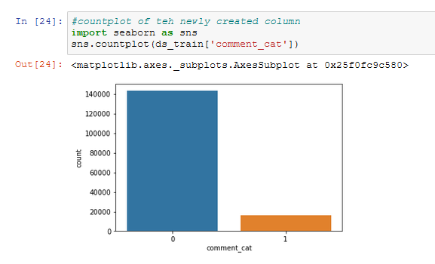
Countplot of target variable
0 is for normal comment
1 is for malignant comment

Slide 8
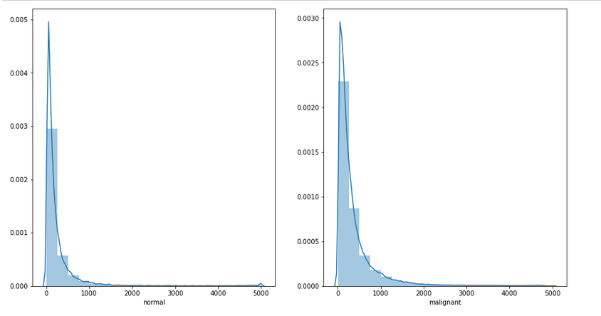
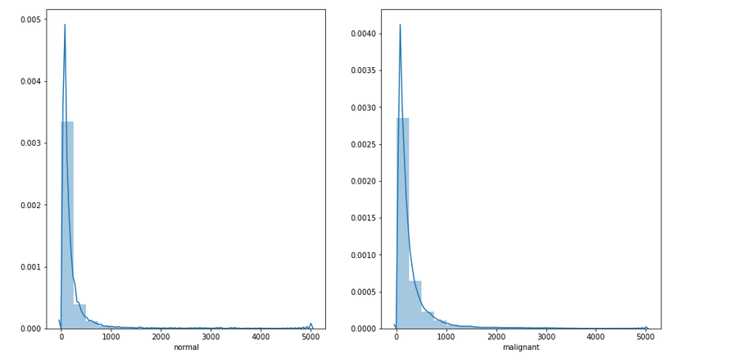
Distplot of length of actual comments
Distplot of length of cleaned comments

Slide 9
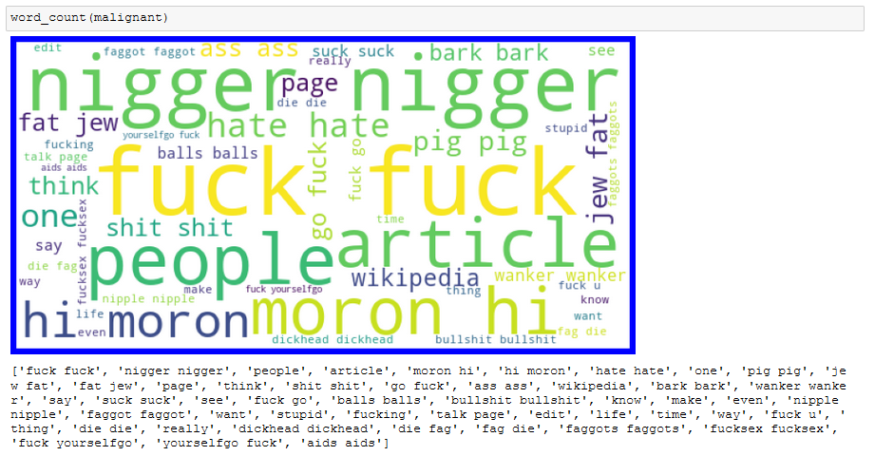
Wordclouds for extracting frequently occurring words

Slide 10
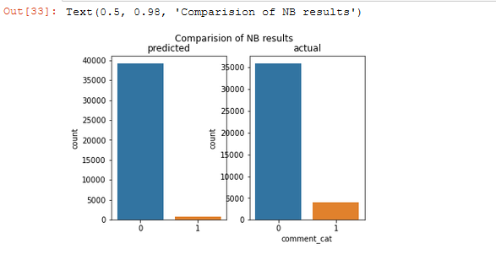
Countplots of actual and predicted values

Slide 11
results
 | Accuracy | Precision | Recall | F1-score
Naïve Bayes Classifier | 0.92 | 0:0.92 1:0.99 | 0:1.00 1:0.19 | 0:0.96 1:0.32
Decision Tree Classifier | 0.93 | 0:0.97 1:0.67 | 0:0.96 1:0.71 | 0:0.96 1:0.69
Random Forest Classifier | 0.94 | 0:0.95 1:0.81 | 0:0.98 1:0.58 | 0:0.97 1:0.98

Slide 12
conclusion
Sentiment analysis proves to be a better approach when dealing with multiple classes in text
Comparison of predicted and actual results help greatly to get an idea of model performance
Visualization of the frequently occurring words in text data greatly helps to get an idea of how a particular class might look and helps the model to better recognize the provided data.
Data cleaning helps reduce the processing time in case of text data.
Visualization of results must be done to get an idea of model performance.

Slide 13
Thank you!

